Slide 1


Carbon and Oxygen isotopes in Nuclear Lattice Effective Field Theory
Young-Ho Song (IRIS, IBS)
2025.05.29. INPC2025, Daejeon, Korea

Slide 2

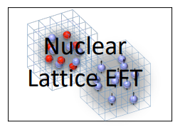
NLEFT collaboration
Nuclear Lattice Effective Field Theory ( NLEFT )
International Collaboration
(USA, Germany, China, Turkey, Korea etc.)
This work:
Young-Ho Song
Myungkuk Kim, Youngman Kim
Kihyeon Cho
Serdar Elhatisari
Dean Lee, Yuan-Zhuo Ma
Ulf-G. Meißner

Slide 3
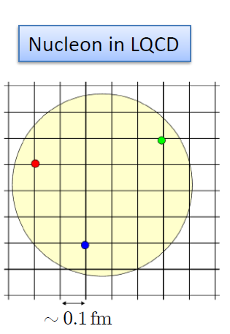
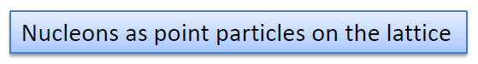
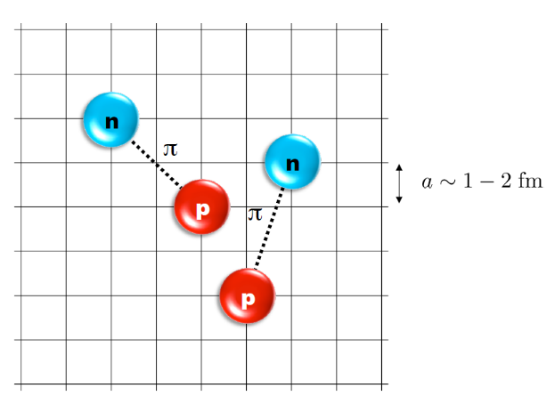
Nuclear Lattice Effective Field Theory
NLEFT = Lattice + Monte Carlo+ Chiral EFT
Lattice
Lattice spacing : a ~ 1 fm
Lattice size : L ~ 10 a
Cutoff of the theory
Monte Carlo
Expectation value
by Auxiliary field MC
Polynomial scaling
Chiral EFT
2N interaction
3N interaction

Slide 4
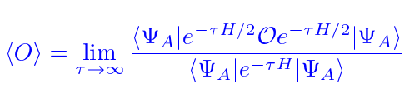
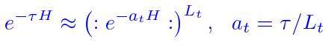
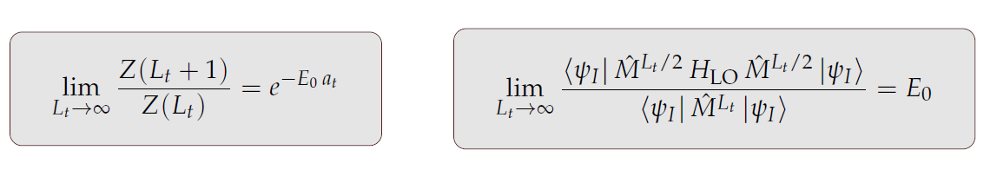
Auxiliary Field Monte Carlo
Expectation value of an observable by projecting WF at large Euclidean time
Discretization in Euclidean time evolution by transfer matrix

Slide 5
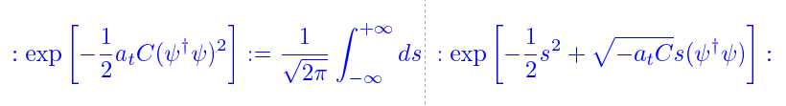
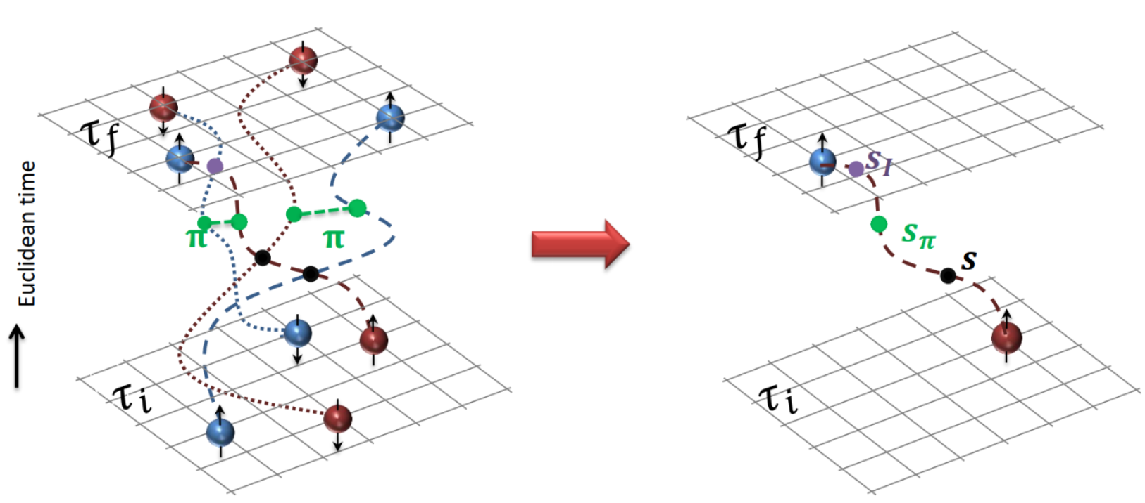
Auxiliary Field Monte Carlo
Transform transfer matrix via Gaussian integral of auxiliary fields
Interacting nucleons
Nucleons interacts with auxiliary fields
(no direct interaction
between nucleons)
computing fermion
Correlator amplitude
Integration
over auxiliary fields
M.C. integral
(sampling auxiliary field)

Slide 6
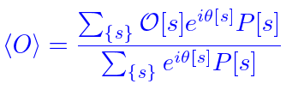
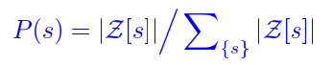
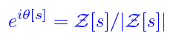
Auxiliary Field Monte Carlo
Auxiliary field integration → M.C. Sum of Auxiliary Fields Samplings
Probability and Phase factor
Sign oscillation from complex phase factor
→ Major limitation in practical AFMC calculation.

Slide 7
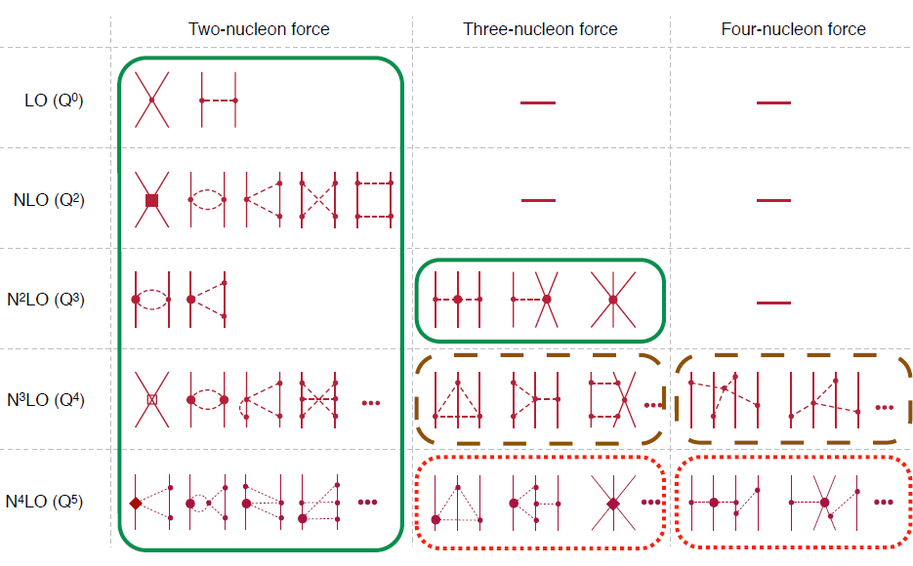
Chiral Effective Field Theory

Slide 8
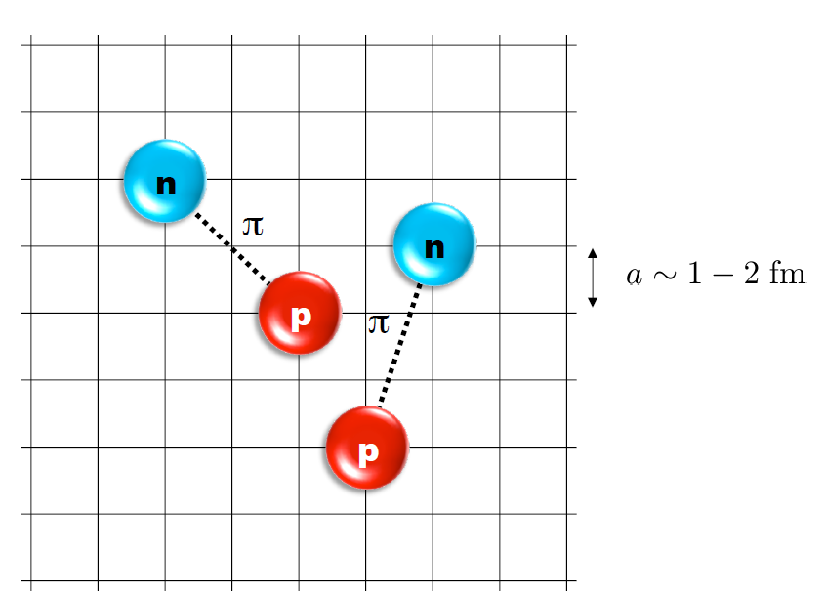
Lattice Hamiltonian
However, one cannot simply adopt the chiral interaction in continuum into lattice.
momentum space cutoff ~ 150 MeV → lattice spacing a= 1.316 fm
Time cutoff ~ 1000 MeV
We need to determine coefficients of interaction for the lattice size. (regularization scale.)
Two-body interaction coefficients can be determined from phase shifts of np scattering.
Three-body interaction can be fixed from binding energy of A>=3.

Slide 9
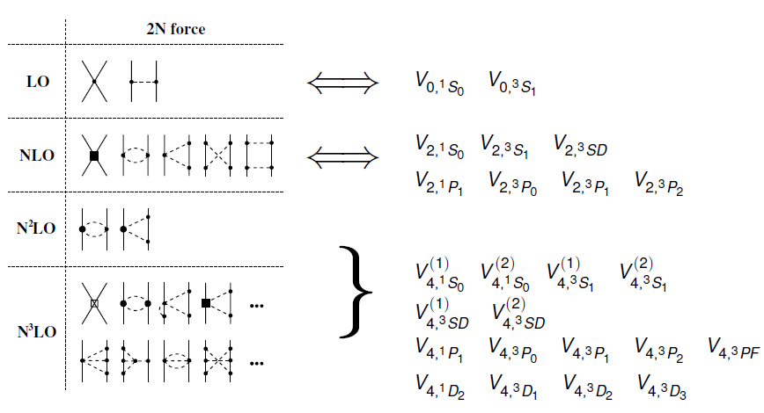
Lattice Hamiltonian

Slide 10
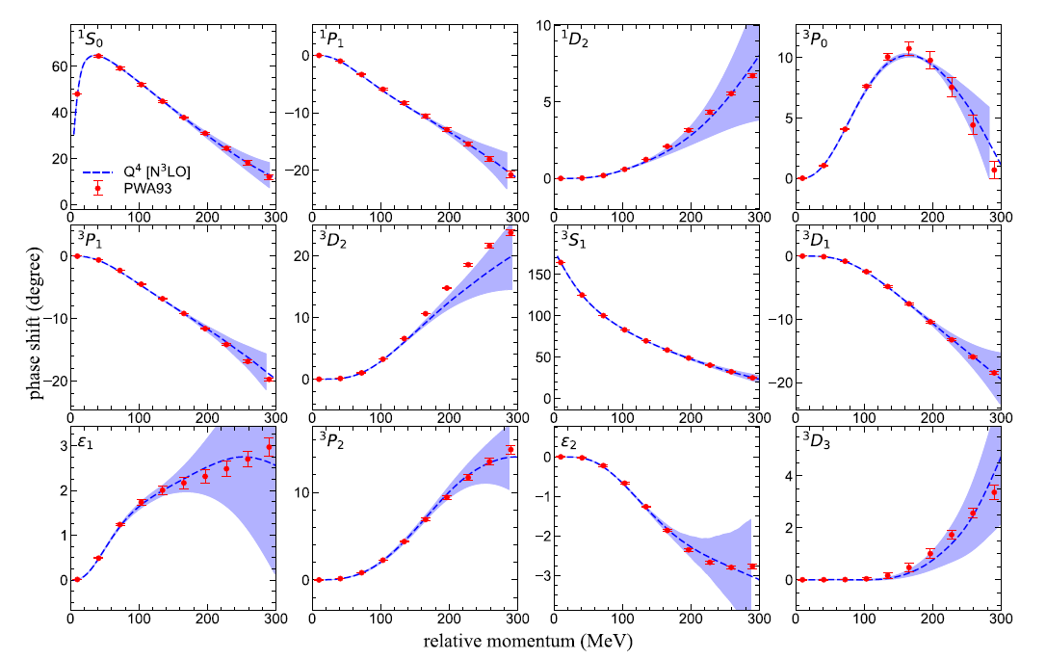
Lattice Hamiltonian
Determine
Higher order NN interaction
From the
phase shifts of NN scattering.

Slide 11
Lattice Hamiltonian
Full N3LO Hamiltonian includes
Free Hamiltonian(Kinetic term)
Short range (nonlocal smeared) contact interactions up to Q^4 order
Isospin-breaking short range interactions
One pion exchange potential
Two pion exchange potential up to Q^4 order
Coulomb interaction
Long range isospin breaking interaction( isospin dependence in OPE)
Galilean Invariance Restoration (GIR) term (because of non-local interaction.)
Three nucleon interaction
Severe Sign problem
need to reduce the sign problem

Slide 12
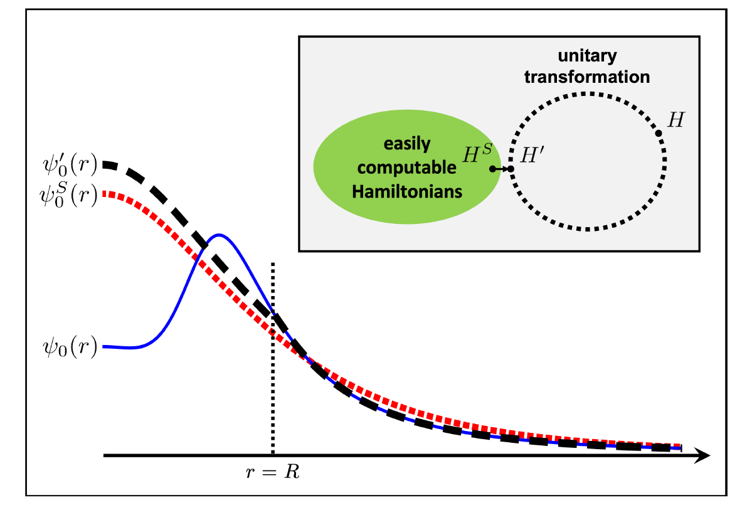
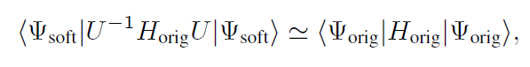
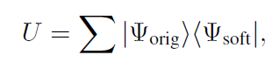
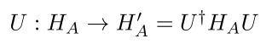
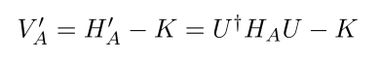
Wave function matching
H and H’ are fully equivalent to two-body observables
The goal is to make the perturbation expansion from “simple” wave function gives a good convergence
U is only active
At r < R
Two potentials V_A and V’_A are unitarily equivalent.
Same phase shifts.
H’_A has eigenvectors of H_B, but eigenvalues of H_A

Slide 13
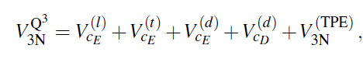
Wave function matching Hamiltonian
N3LO Hamiltonian
V_2N : short range NN interactions
W_2N: GIR restoration term for V_2N
V_2N,WFM : difference from H’-H
W_2N,WFM: GIR restoration correction to V_2N,WFM
V_3N : contains short range 3N interaction parameters(to be fitted)
and two pion exchange correction to 3N

Slide 14
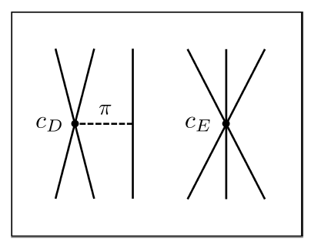
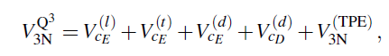
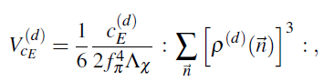
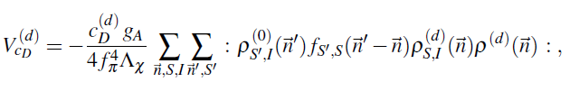
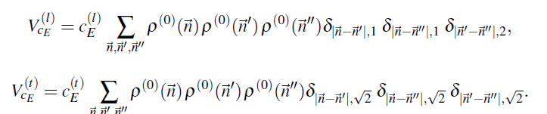
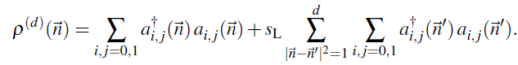
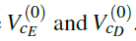
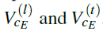
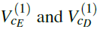
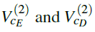
Wave function matching Hamiltonian
Three-body Force
NNLO
At N3LO:
TPE and
Adjustments to
cD and cE terms.

Slide 15
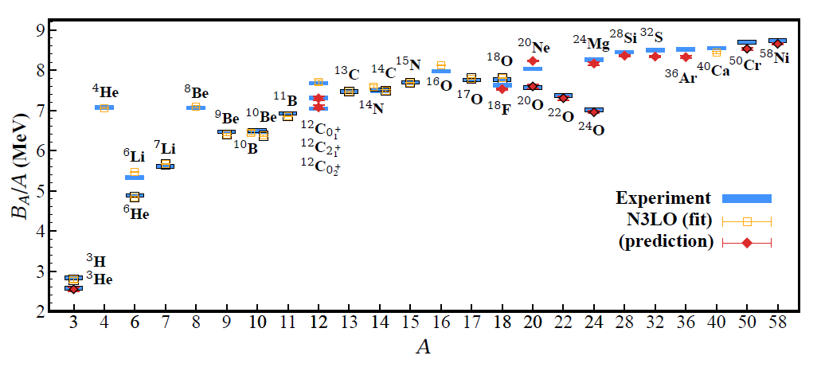
BE/A from WFM
RMSD ~ 0.1 MeV per nucleon

Slide 16
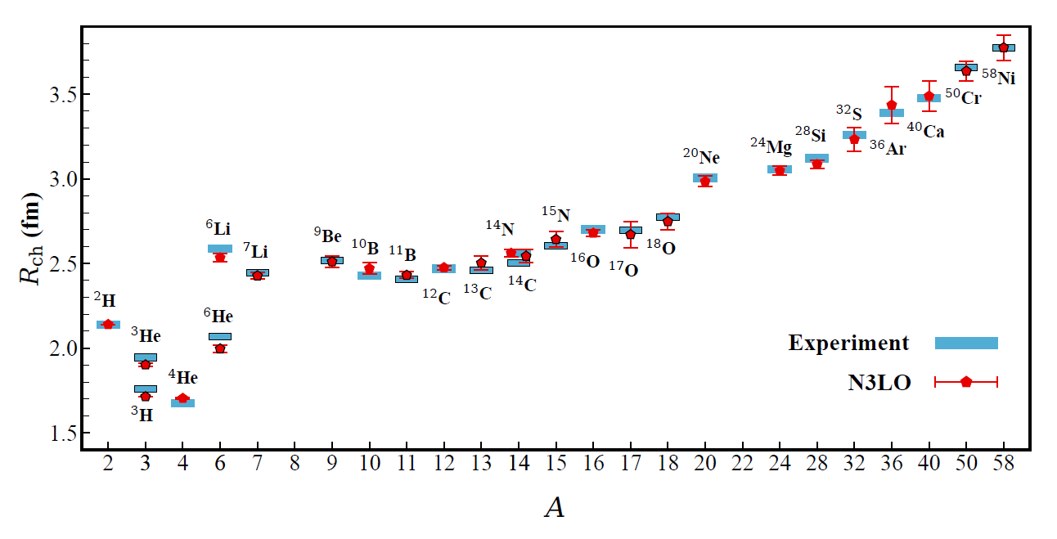
Charge Radius
No fitting! RMSD~ 0.03 fm

Slide 17
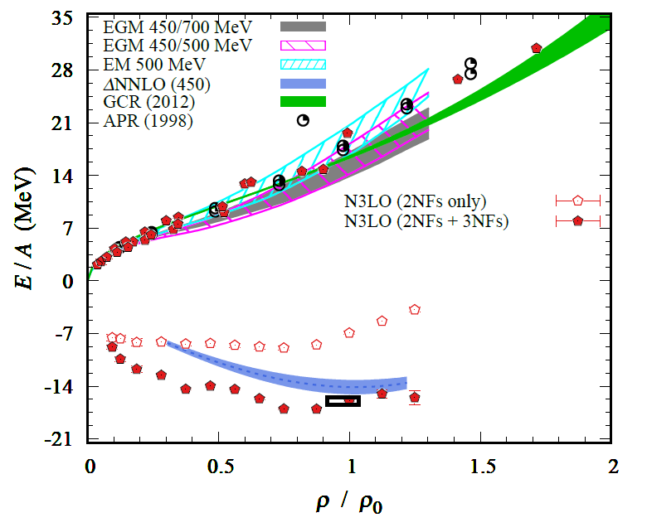
Nuclear/Neutron Matter
Neutron matter:
A=4~80
box size 6.6 ~ 13.2 fm.
Nuclear matter:
A=4 ~ 160
Box size 7.92~9.24 fm.
Uncertainties from
finite system size correction

Slide 18
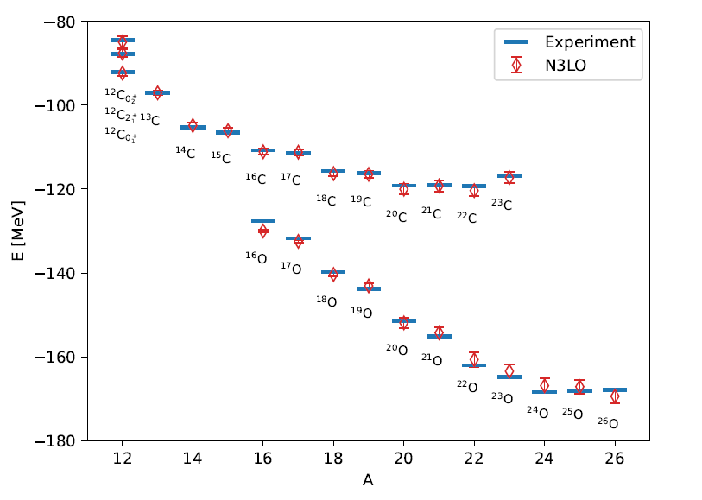
Carbon and Oxygen
WFM method
Carbon and Oxygen isotopes

Slide 19
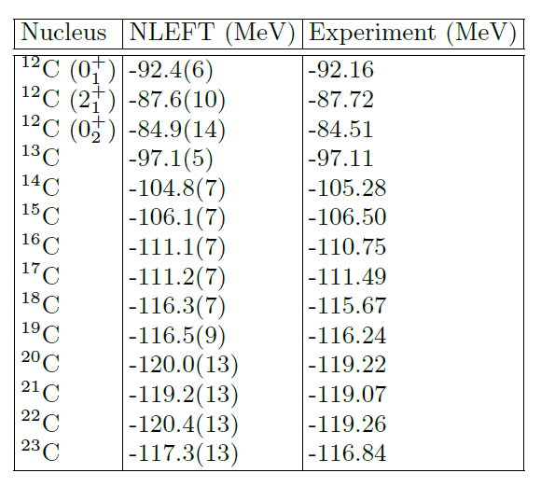
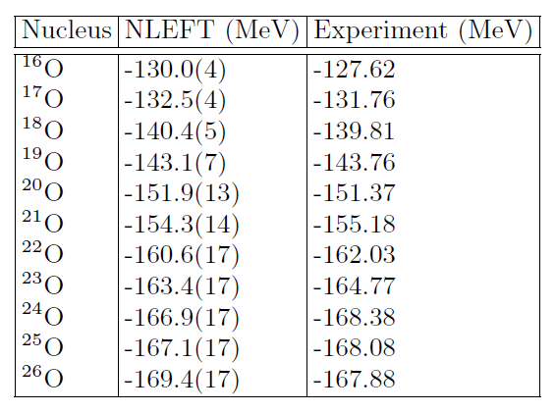
Carbon and Oxygen

Slide 20
Carbon isotopes (Lt=200)

Slide 21
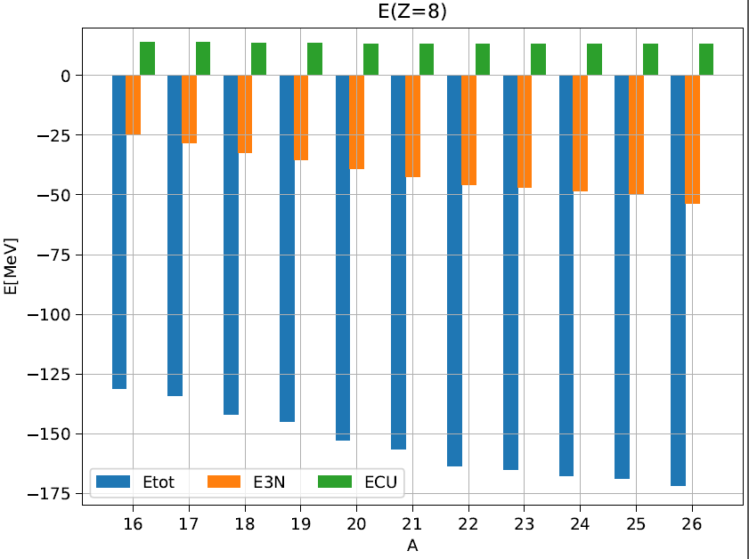
Oxygen isotopes (Lt=200)

Slide 22
Partial wave contributions
Operator expectation values
Not a physical observable
Phase shift
(quasi) physical observable
Sensitivity of a quantity on
phase shift change
→ Model independent quantity
1% phase shift change at p=150 MeV
Corresponding to cutoff scale in NLEFT

Slide 23
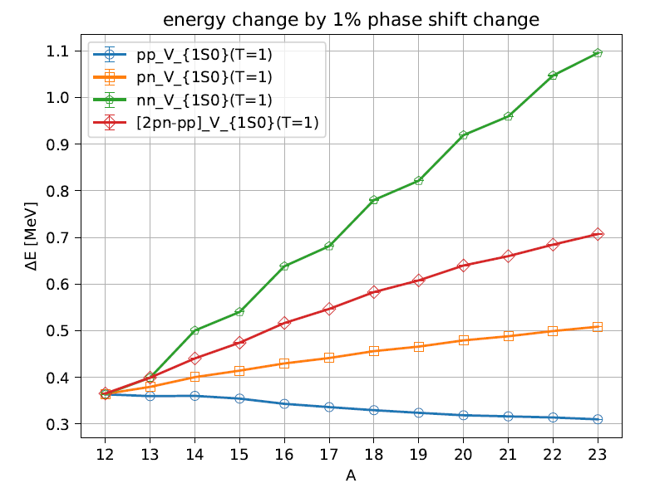
1S0 contributions
1% Phase shift change
At p=150 MeV in 1S0
Change in two-body energy
Z= 6
<pp1S0> : near constant
<nn1S0> : strong correlation among paired neutrons
Carbon isotopes

Slide 24
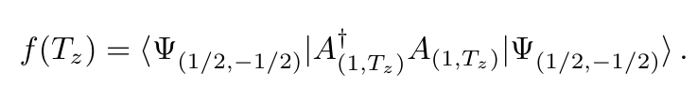
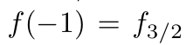
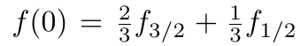
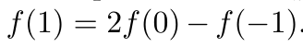
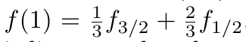
Tz linearlity
A(1,Tz) is a two nucleon annihilation operator
which gives isospin change by (1, Tz)
f(-1) : two proton operators ( two-body interaction) expectation value
f(0) : proton-neutron operators
f( 1) : two neutron operators

Slide 25
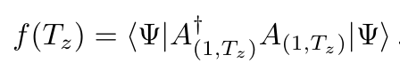
Tz linearlity
If each of extra neutrons are uncorrelated with each other
Independent particles (= core +valences)
(2) zero contribution among valence neutron pairs
→ Difference between left and right is
a measure of correlation between additional neutrons.

Slide 26
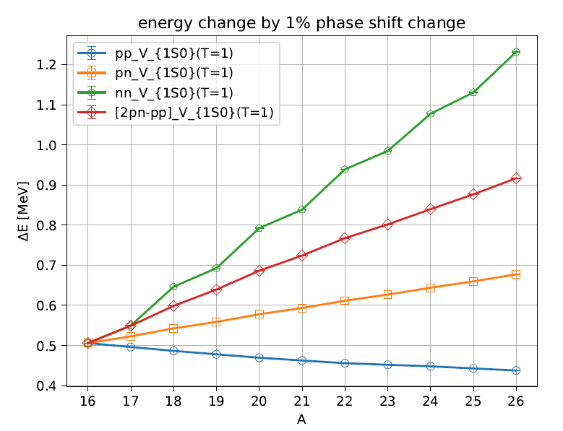
1S0 contributions
Carbon and Oxygen isotopes: additional odd neutron shows similar slope for <nn> and <2pn-pp>

Slide 27
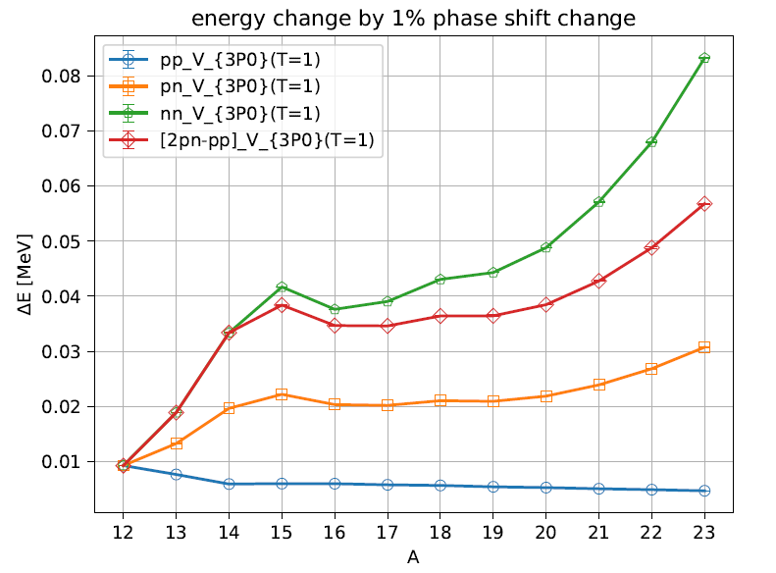
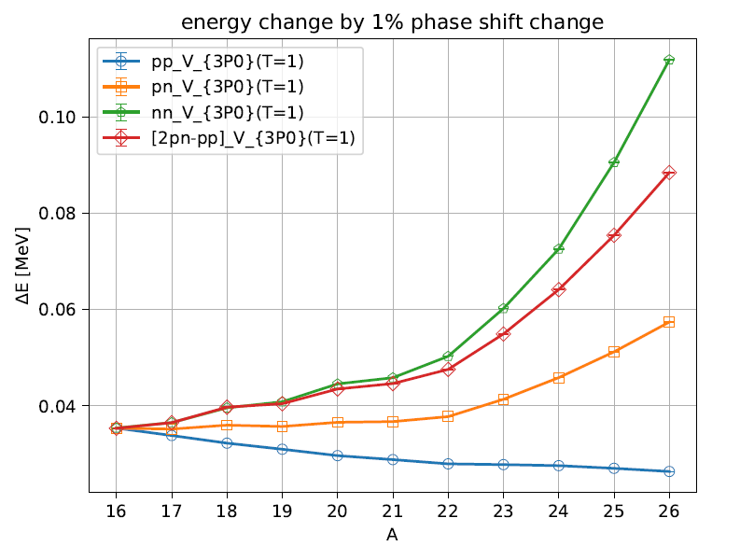
3P0 contributions
3P0 is less sensitive to the phase shift change than 1S0
Roughly consistent with naïve shell model s.p. level structures.

Slide 28
Summary
Wave function matching method seems to be promising
Carbon, Oxygen isotope up to dripline shows good agreement with experimental data
Analysis of partial wave contribution enables to study
(mean-field) level structures of nuclei in NLEFT.
Additional neutrons in 1S0 have strong pairing correlation
Unpaired neutrons correlated primarily to the nuclear core.

Slide 29
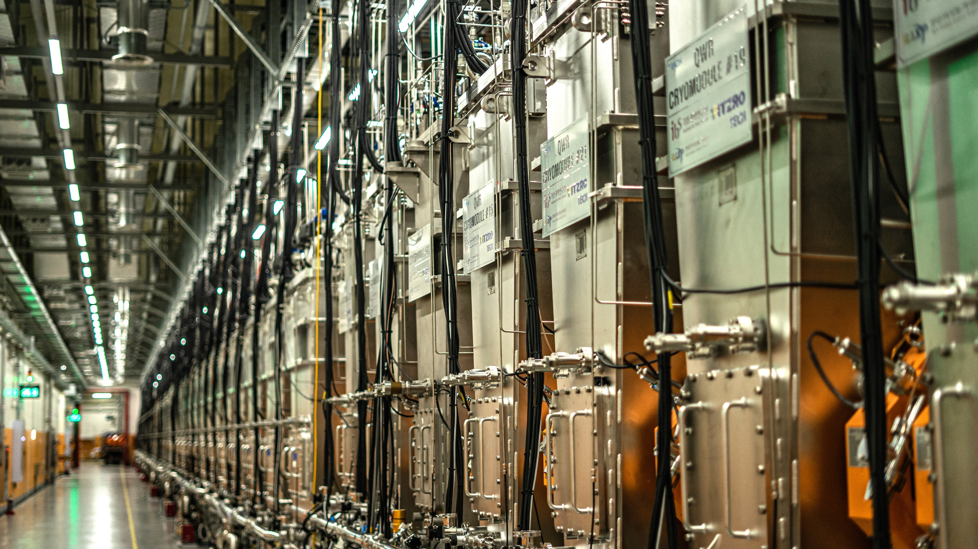
Thank You

Slide 30


3P1 (T=1)

Slide 31


3P2 (T=1)

Slide 32


1D2 (T=1)

Slide 33


3S1 (T=0)

Slide 34


1P1 (T=0)

Slide 35


3D1 (T=0)

Slide 36


3D2 (T=0)

Slide 37


3D3 (T=0)

